Slide 1

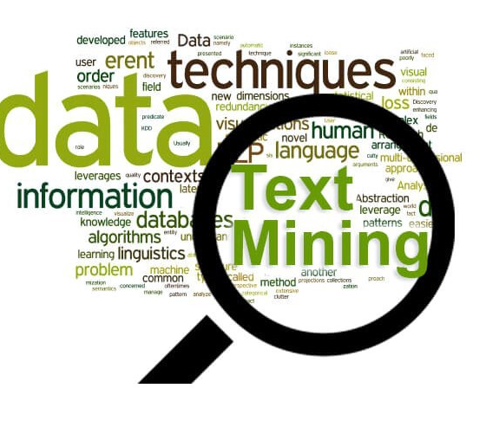
Text tagging using NLP
Capstone Project – Data 606
Srinivasa Akhil Vutukuri

Slide 2
RECAP :
New aggregator dataset with 400,000 rows and with 8 columns
This dataset is around a span of 6 months from march to august 2014
Main columns are category , title , web link , Unix time
Found patterns and seasonality's in my data in deliverable 2
Along with the exploratory analysis I also did some cleaning of my text data
Project aim :
Finding patterns and seasonality's in dataset
To categorize the articles which include business , entertainment, medical and science and technology using their headlines
Retrieving the actual article using article link from the website and finding the similarities if the articles on the similar topic.

Slide 3
Text cleaning
Removing numbers
Single case
Stop words
Punctuations
Lemmatization
Stemming

Slide 4
Transforming data for model
Scikit learn expects numeric values where as my data is text
Using label encounter on my category to convert text to number based
Vectorizing headline column to convert into matrix form and tokens are scikit works with numeric values
Since data is multiclass data , regular regression models faces issues
Using onevsrestclassifer which helps normal regression model to be compatible with multiclass data

Slide 5
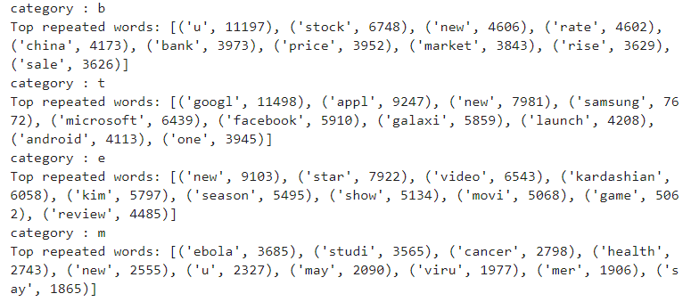
Data Exploration
Identified top words in the articles
Top words in every field

Slide 6
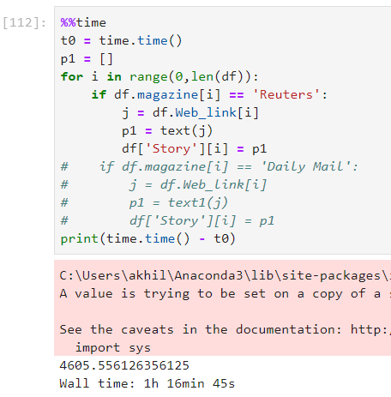
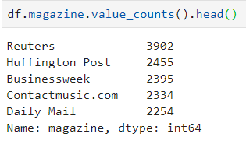
Data retrieval techniques
Tried retrieving data using the html article link
Huge time taking process
Faced some issues as some of the e – articles are not active right now as the support by the website is stopped

Slide 7

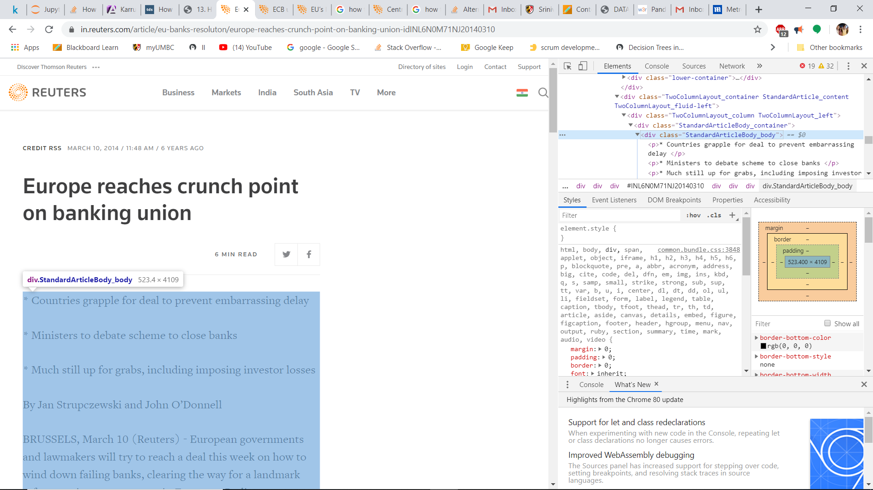




Slide 8
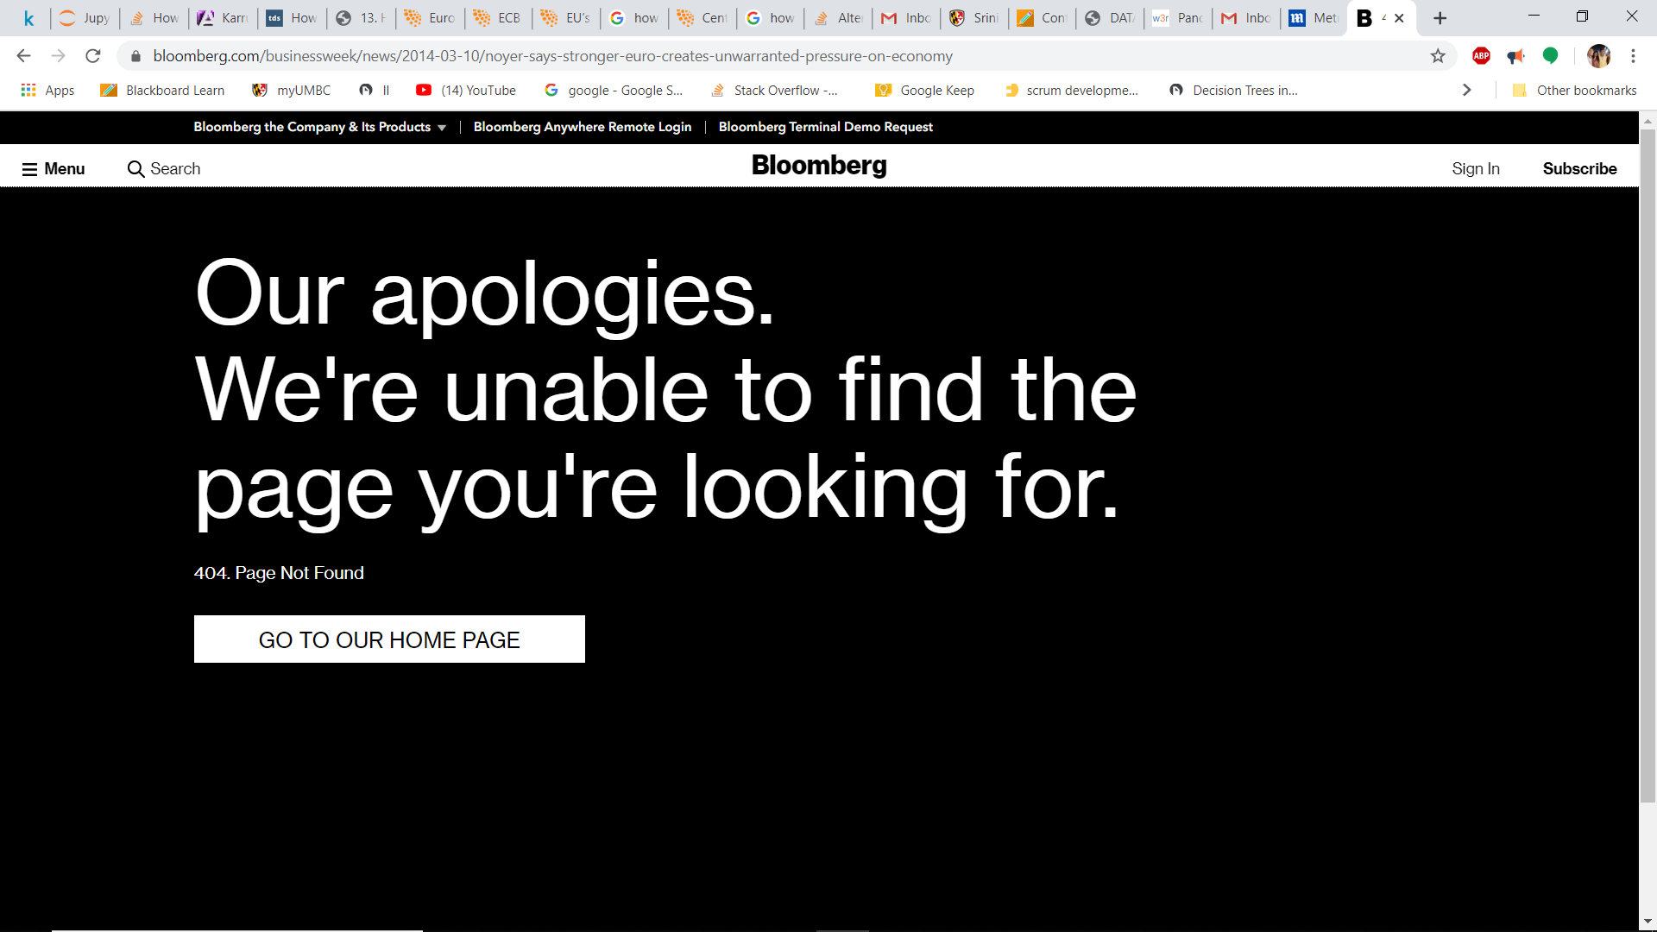

Slide 9
Models
Logistic
Naïve Bayes
Would like to work on
Decision tree
Random forest
svm

Slide 10
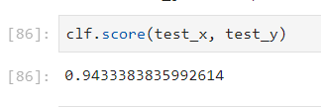
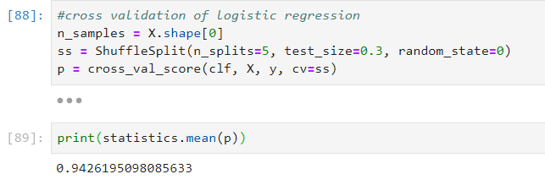
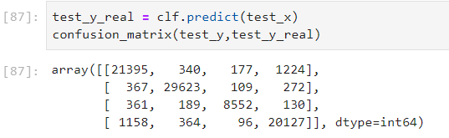
Logistic regression
Perfect for categorical data
Got an good accuracy
Initially though it is over fitting
So, cross validated with shuffle spilt from sklearn to check
Got similar accuracy

Slide 11

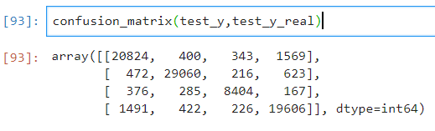
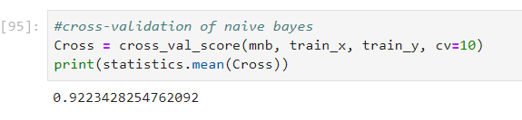
Naïve Bayes
Similar to logistic, got good accuracy
I thought would get much higher than logistic
Cross validated to check

Slide 12


Decision Tree
Didn’t get as expected
Used multiclass to boost but Results are not quite good
Will try to improve by changing parameters and would like to work on it

Slide 13
Conclusion and Future Work
Got some good conclusions from text data
Got some of my initial assumptions right regarding top words and articles
Retrieving data from article html link efficiently
Got some excellent results from unexpected models
Need to work on other models like svm, random forest and need to optimize the data for better results
Would like to retrieve the articles and find the similarities between similar articles which I am thinking of using time parameter for the base comparison

Slide 14

Thank You
Any doubts or feedback
Mail me at v39@umbc.edu

